Slide 1
URETERAL STONES
Hossni Fathalla
Assistant Lecturer
Urology department –Sohag university

Slide 2
TYPES OF STONES
75% calcium oxalate or phosphate
15% phosphate-containing, most commonly struvite (magnesium ammonium phosphate)
5-10% uric acid
1% cystine
Rarely, pure matrix and indinavir deposition

Slide 3
LOCATIONS OF STONES
Ureteropelvic junction (UPJ)
Pelvic brim (at the bifurcation of the iliac vessels where the ureter courses anterior and medial to the vessels and is compressed)
Ureterovesical junction (UVJ)

Slide 4
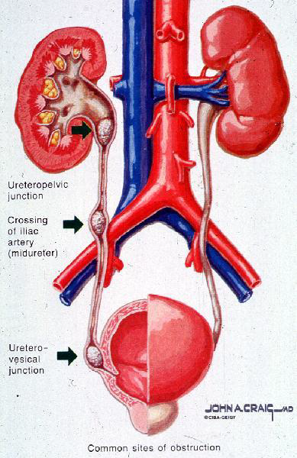

Slide 5
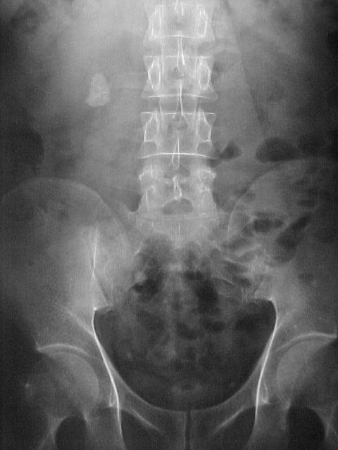

Slide 6
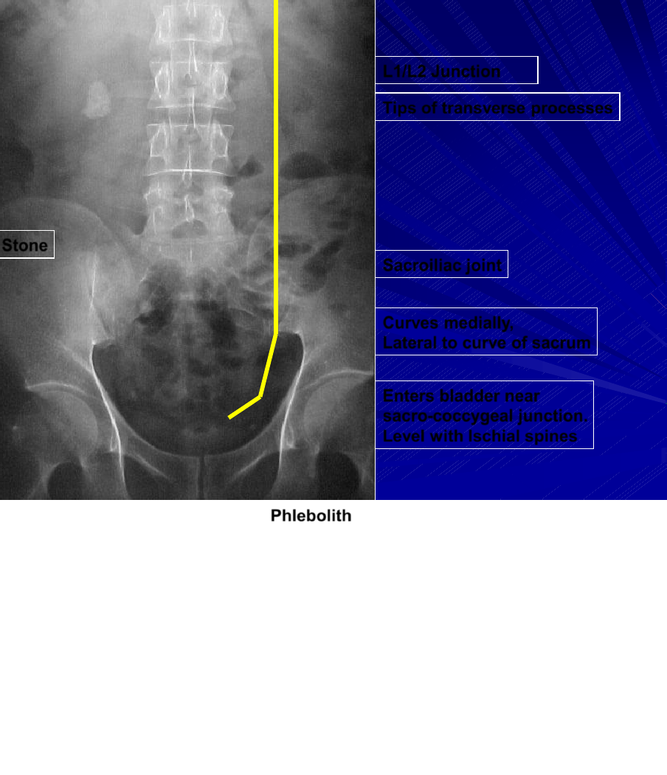

Slide 7
SIGNS AND SYMPTOMS
Severe, intermittent unilateral flank pain that radiates to the groin causing the patient to writhe around at its height of intensity
Microscopic hematuria
If febrile, then may be a complicated ureteral obstruction by either infection with obstruction or acute pyelonephritis

Slide 8
DIFFERENTIAL DIAGNOSIS
Genitourinary causes: pyelonephritis, torsion of a pelvic mass
Gastrointestinal causes: appendicitis, diverticulitis, cholecystitis, choledocholithiasis, pancreatitis, bowel obstruction, Crohn’s disease, torsion of an abdominal mass
Vascular causes: aortic dissection, ruptured abdominal aortic aneurysm

Slide 9
PLAIN RADIOGRAPHY
Relies solely on the identification of a calcific density along the expected ureteral tract
Only 59% of ureteral calculi are visible
Cystine stones are mildly radiodense
Uric acid, pure matrix, and indinavir stones are radiolucent

Slide 10
ULTRASOUND
Detects indirect signs of obstruction: collecting system dilatation, a change in renal blood flow, a loss of a ureteric jet
Rarely identifies urolithiasis except at the UPJ or UVJ
Difficulty in measuring the size of a stone

Slide 11
INTRAVENOUS Urography (IVU)
Advantages: availability, low cost, ability to assess renal function
Disadvantages: requires intravenous contrast, prolonged exam time, inability to assess other causes of the clinical presentation, difficulty in distinguishing calcific densities ,Not done during colic.

Slide 12
IVP: Radiographic Findings of Ureteral Stone Obstruction
Opacity along the urinary tract
Dilatation of ureter down to obstruction
Dilatation of collecting system
Delay in contrast of nephrogram
Delay in contrast of collecting system
Delay in contrast excretion

Slide 14
NON-CONTRAST Multisice CT (NCCT)
Imaging modality of choice
Advantages: speed, safety, ability to assess other causes of the clinical presentation.
Disadvantages: Inability to assess renal function.

Slide 15
MAGNETIC RESONANCE UROGRAPHY (MRU)
Identifies stones and some secondary signs of obstruction
Advantages: no radiation and contrast
Disadvantages: inability to image unobstructed urinary tract, expensive.
During pregnancy.

Slide 16
MRU

Slide 17
URETERAL CALCULI TREATMENT
CONSIDERATIONS
Location
Size and density.
Chronicity (more than 4 weeks).
Equipment
Expertise

Slide 18
TREATMENT OPTIONS
Observation and medical expulsive therapy.
Shock wave lithotripsy (ESWL in upper ureteric stones).
Ureteroscopy
Percutaneous approach(Upper ureteric stones).
Open surgery

Slide 19
CONSERVATIVE MANAGEMENT
Non steroidal antiinflammatory(e g Diclophenac).
Alpha blockers (Tamsulocin).

Slide 20
ESWL
Extracorporeal shock wave lithotripsy (for proximal ureteral stones and least invasive therapy)
Contraindications:Pregnancy and bleeding disorders.

Slide 21
Ureteroscopy

Slide 23
Ureteroscopy
Easier for lower stones
Extraction of stone fragments
Fragmentation
–Laser Homium Yg
– Electrohydrolic.
–Pneumatic.
–Ultrasound

Slide 24
Thank You

